Slide 1

CAPSTONE PROJECT Project name :- Android google play store applications analysis Name :-Akashdeep Singh Student ID: - 0771949 Name of Supervisor:- Dr. Savita Seharawat Date of Submission:- 31st January

Slide 2
BASIC INFORMATION ABOUT PROJECT(ABSTRACT) My project name is Android Google Play, moreover known as the Google Play Store, and in which I used androiddataset.csv dataset in which 1048575 records and 24 attributes. With the help of android google play store we will download or purchase millions of apps, diversions, and other media onto your Android gadget. You'll be able discover programs for a wide cluster of interface. You'll be able download apps or recreations by exploring to the app or amusement page inside the Play Store and tapping Introduce. Numerous apps will be free, a few will have in-app promotions, a few will fetched cash, whereas others may offer in-app buys, or a combination of any of these things. For those who are interested, there's the Google Play Pass, which allows you to download hundreds of apps and recreations for complimentary, without advertisements or in-app buys.so in this data we have some important attributes and value that help us to understand all functions of this dataset. Its a stage. It’s Google’s stage for advertising different advanced substance to its customers. Opposite to what a few individuals may think, the Google Play Store isn't fair an app store, not at all. You'll discover all sorts of substance accessible here. The Google Play Store is domestic to music, motion pictures, books, and recreations

Slide 3
RESEARCH QUESTIONS: Question 1)- find how many applications are free ,ad supported ,in purchases using pie chart? ANSWER: 99.4 % applications are freed from price for the clients , also equal percentage is observed in programs that supported advertisements that is 99.4% and 0.6% applications are paid and additionally no longer supported ads. Question – 2) Which category of content rating show highest numbers that shows rating corresponding to application. ANSWER: From all categories of content material score I find that humans those are 18+ , they give more score to the programs. Question 3) find accuracy of this project(dataset) by using different methods and also compare each other model to check which one is best as compare to the others? ANSWER: I used four models to find accuracy of this project That is Logistic regression , KNN model ,Naïve bayes model and random forest classifier model . Logistic regression accuracy is 59.33 KNN model accuracy is 54.91 Naïve bayes model accuracy is 59.09 Random forest classifier accuracy is 56.88 So accuracy that we find with the help of logistic regression is best for our model that is 59.33

Slide 4
Methodology:
Data preprocessing
Experimental Design
Model implementation and value
Conclusion

Slide 5
Numerical attributes
contain summary of dataset it is showing the numeric attributes of count, mean or average, is calculated by adding up the scores and dividing the total by the number of scores, standard deviation is a measure of dispersion of data values from the mean.
Attributes Name | count | mean | std | min | 25% | 50% | 75% | max
Rating | 1038265 | 2 | 2 | 0 | 0 | 3 | 4 | 5
Rating_Count | 1038265 | 2937 | 255967 | 0 | 0 | 6 | 42 | 1.39E+08
Minimum_Installs | 1048529 | 176200 | 13259642 | 0 | 50 | 500 | 5000 | 5E+09
Maximum_Installs | 1048575 | 304457 | 20466334 | 0 | 84 | 695 | 7361 | 9.77E+09
Price | 1048575 | 0 | 3 | 0 | 0 | 0 | 0 | 400

Slide 6
Missing values
Missing values are the null values in a dataset. When there is no value stored for any variable in an observation then that condition is treated as null/missing or N/A value. If there is an availability of null values in any dataset, then our result will never be accurate
Developer_Website | 100692
Privacy_Policy | 55600
Released | 9349
Rating | 3033
Rating_Count | 3033

Slide 7
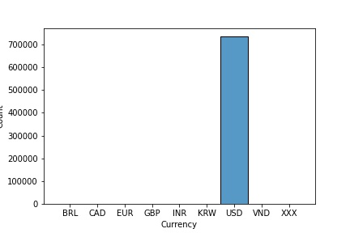
Data Visualization:- Counts vs currency:
FIGURE 3. Count vs currency
This bar graph represents the information between currency and counts. We can see that from this graph that the counts of USD foreign money has highest as compared to others. It is nearly 700000.

Slide 8
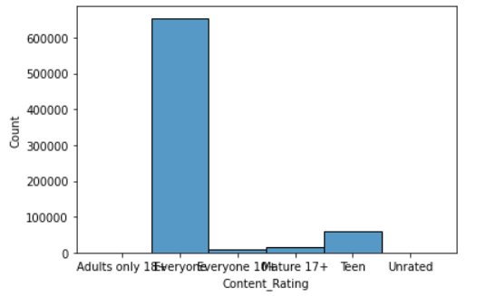
Show highest Content rating category
FIGURE 4. Count vs Content_Rating
We can noticed that people who are 18+ that human beings give highest score to the content material of all software as evaluate to the alternative classes adults most effective, every body, mature, 17+, Teen, Unrated) like extra then as a 60,00,00 counts number.

Slide 9
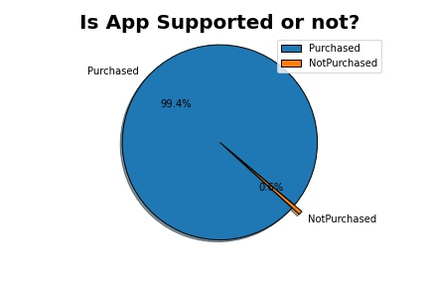
Show how many applications are supported purchased feature.:-
FIGURE 5. Is App Supported or Not?
In above pie chart the blue color represent the percentage of apps that are purchased this is 99.4% and
the yellow coloration represents the apps which are not bought which might be 0.6%.

Slide 10
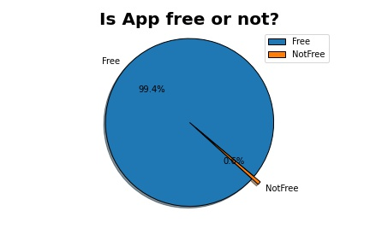
Show how many applications are free of cost to the customer:-
FIGURE 6. Is App Free or Not?
The above pie chart is showing the percentage of apps which can be free or not loose.
There are 99.4% apps which can be free of price. And the relaxation aren't free.

Slide 11

Model implementation
K-nearest neighbour
Logistic regression
Naïve bayes
Random forest classifier
Cross validation

Slide 12
Modelling
In the modelling part there are four methods Logistic Regression, KNN, Naive Bayes, random forest that I have applied on my dataset.
Logistic Regression: It is classification machine learning algorithm that is used to predict the probability of categorical dependent variable.
KNN: The KNN stands for “K-Nearest Neighbour”. It is a supervised machine learning algorithm. The algorithm can be used to solve both classification and regression problem statements. The number of nearest neighbours to a new unknown variable that has to be predicted or classified is denoted by the symbol 'K'.
Naive Bayes: It is classification algorithm that is suitable for binary and multiclass classification.
It performs well in cases of categorical input variables compared to numerical variables.
Random Forest CLASSIFIER: It is a Supervised Machine Learning Algorithm that is used widely in Classification and Regression problems. It is also a meta estimator that fits a number of decision tree classifier on various sub-samples of the dataset and uses averaging to improve the predictive accuracy and control over-fitting. Cross Validation:- In cross validation, the training set is randomly split into k(usually between 5 to 10) subsets known as folds. Where k-1 folds are used to train the model and the fold is used to test the model.

Slide 13
Models result
Model | train_test_split
0 | Logistic Regression | 59.334262
1 | knn | 54.917170
2 | Naive Bayes | 59.098932
3 | Random Forest | 56.880322
After implementation of models we can see logistic regression model is the best model to find accuracy of the project that is 59.33 that is best accuracy of the different models.

Slide 14
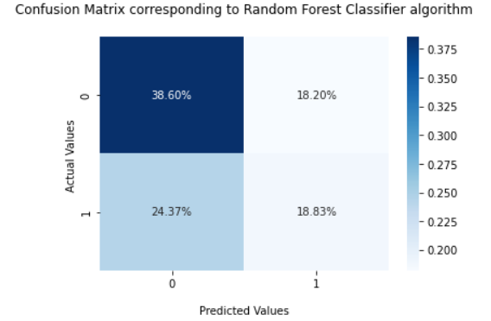
Confusion Matrix Corresponding to Random Forest Classifier Algorithm:-
Well, it's far a overall performance measurement for machine learning trouble where output may be two or extra lessons. It is a table with 4 exceptional mixtures of predicted and actual values. And it a tabular summary of the quantity of correct and wrong predictions made by way of a classifier.
FIGURE 7. Actual Values Vs Predicted Values
Confusion Matrix Corresponding to Random Forest
When the target variable's actual value is 0 and the predicted value is also 0 and 38.60% of observation fall into first quadrant. 18.20% of
observations fall into the second quadrant; whilst the target variable's actual value is 0 and predicted value is 1. 24.37% of observations fall into
the third quadrant; and while the target variable's actual value is 1 and predicted value 0, 18.83% of observations fall into the fourth quadrant.
The actual and predicted values are each 1.

Slide 15
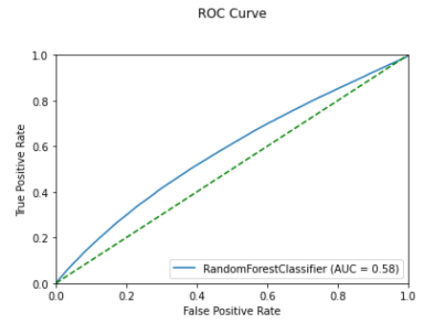
ROC CURVE (RECEIVER OPERATING CHARACTERISTIC):- Roc curves are widely used in binary classification to study the output of a classifier ROC curve, is a graphical plot that illustrates the diagnostic ability of a binary classifier system as its discrimination threshold is varied.
FIGURE 8. True Positive Rate Vs False Positive Rate
FROM ABOVE GRAPH, AREA UNDER THE CURVE SCORE IS 0.58. IT SHOW THAT IT IS AN OPTIMAL CLASSIFIER.

Slide 16
END OF PRESENTATION

